Slide 1
CHAPTER – 3
DATA AND SIGNALS

Slide 2
OUTLINE
Analog signals
Digital signals
Transmission impairments
Data rate limits
Performance

Slide 3
ANALOG AND DIGITAL DATA
Data can be analog or digital.
Analog data are continuous and take continuous values.
Digital data have discrete states and take discrete values.
Think about an analog and a digital clock.

Slide 4
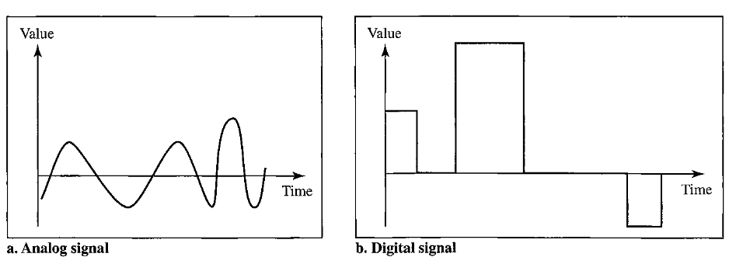
ANALOG AND DIGITAL SIGNALS
Signals can be analog or digital.
Analog signals can have an infinite number of values in a range
Digital signals can have only a limited number of values.

Slide 5
PERIODIC AND NONPERIODIC SIGNAL
A periodic signal completes a pattern within a measurable time frame, called a period, and repeats that pattern over subsequent identical periods.
The completion of one full pattern is called a cycle. A nonperiodic signal changes without exhibiting a pattern or cycle that repeats over time.
Both analog and digital signals can be periodic or nonperiodic. In data communications, we commonly use periodic analog signals (because they need less bandwidth), and nonperiodic digital signals (because they can represent variation in data)

Slide 6
PERIODIC ANALOG SIGNALS
Periodic analog signals can be classified as simple or composite.
A simple periodic analog signal, a sine wave, cannot be decomposed into simpler signals.
A composite periodic analog signal is composed of multiple sine waves.
The sine wave is the most fundamental form of a periodic analog signal.

Slide 7
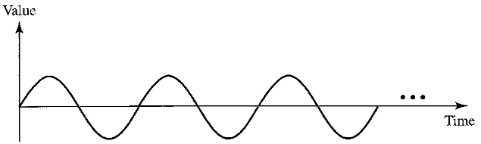
PARAMETERS OF SINE WAVE
A sine wave can be represented by three parameters
  Peak amplitude
  Frequency, and
  Phase.
These three parameters fully describe a sine wave.

Slide 8
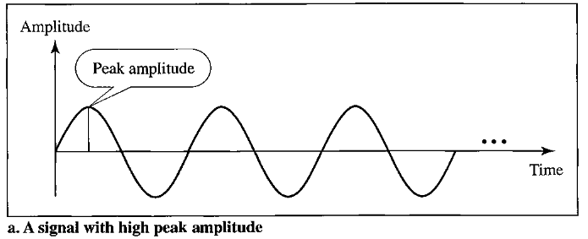
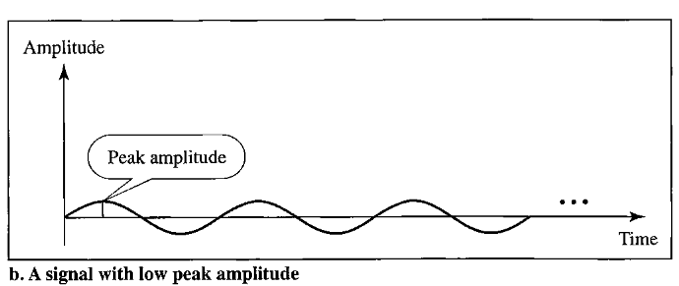
PEAK AMPLITUDE
The peak amplitude of a signal is the absolute value of its highest intensity, proportional to the energy it carries.
For electric signals, peak amplitude is normally measured in volts.

Slide 9
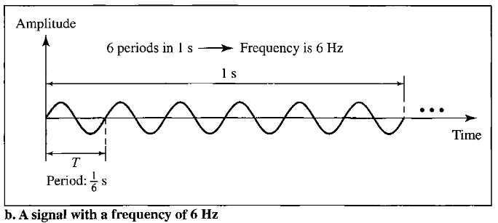
PERIOD AND FREQUENCY
Period refers to the amount of time a signal needs to complete 1 cycle. Represented by seconds.
Frequency refers to the number of periods in 1 s. Represented by Hertz (Hz).
Period and frequency are the inverse of each other.

Slide 10
MORE ABOUT FREQUENCY
Frequency is the rate of change with respect to time.
If the value of a signal changes over a very short span of time, its frequency is high.
If it changes over a long span of time, its frequency is low.

Slide 11
TWO EXTREMES OF FREQUENCY
What if a signal does not change at all, maintains a constant voltage level for the entire time it is active?
In such a case, its frequency is zero. If a signal does not change at all, it never completes a cycle, so its frequency is 0 Hz.
But what if a signal changes instantaneously? What if it jumps from one level to another in no time?
Then its frequency is infinite. When a signal changes instantaneously, its period is zero; since frequency is the inverse of period, in this case, the frequency is 1/0, or infinite.

Slide 12
PHASE
Phase describes the position of the waveform relative to time 0.
If we think of the wave as something that can be shifted backward or forward along the time axis, phase describes the amount of that shift.
It always indicates the status of the first cycle.
Phase is represented in degrees or radians.

Slide 13
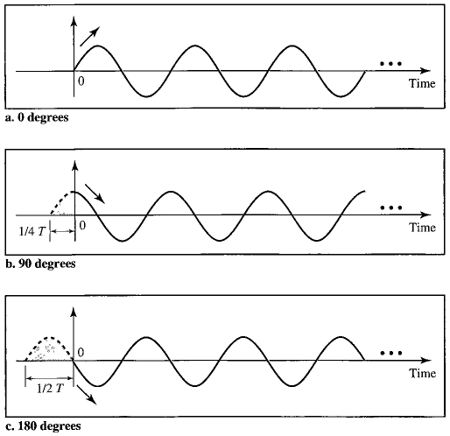
PHASE (2)

Slide 14
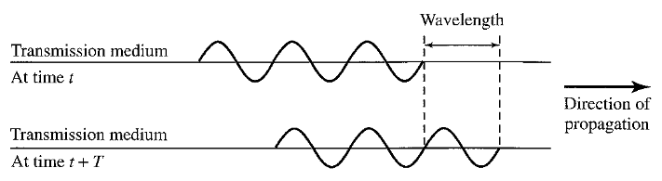

WAVELENGTH
The wavelength is the distance a simple signal can travel in one period.
Wavelength binds the period or the frequency of a simple sine wave to the propagation speed of the medium

Slide 15
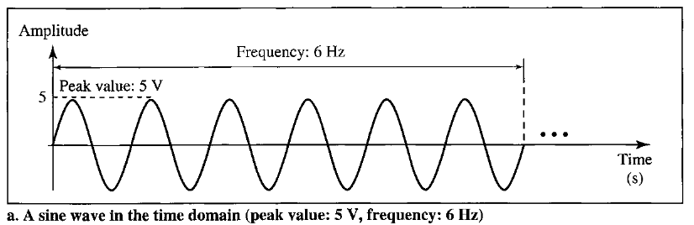
TIME DOMAIN
A sine wave is comprehensively defined by its amplitude, frequency, and phase.
We have been showing a sine wave by using what is called a time-domain plot.
It is an amplitude-versus-time plot. Phase is not explicitly shown on a time-domain plot.

Slide 16
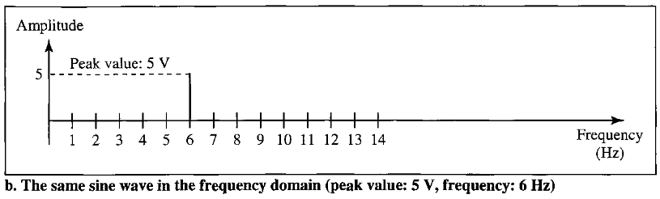
FREQUENCY DOMAIN
To show the relationship between amplitude and frequency, we can use what is called a frequency-domain plot.
A frequency-domain plot is concerned with only the peak value and the frequency. Changes of amplitude during one period are not shown.

Slide 17
FREQUENCY DOMAIN (2)
Frequency domain is easy to plot and conveys the information that one can find in a time domain plot.
The advantage of the frequency domain is that we can immediately see the values of the frequency and peak amplitude.
A complete sine wave is represented by one spike. The position of the spike shows the frequency; its height shows the peak amplitude.

Slide 18
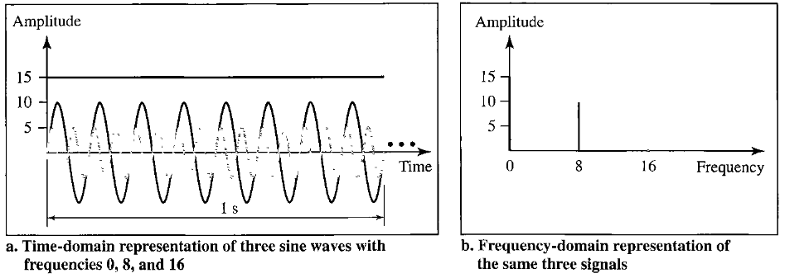
FREQUENCY DOMAIN (3)
The frequency domain is more compact and useful when we are dealing with more than one sine wave.
All the waves can be represented by just three spikes in the frequency domain.

Slide 19
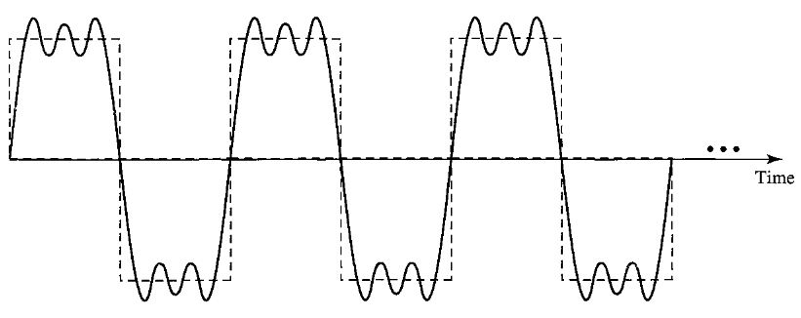
COMPOSITE SIGNALS
If we had only one single sine wave to convey a conversation over the phone, it would make no sense and carry no information. We would just hear a buzz.
We need to send a composite signal to communicate data. A composite signal is made of many simple sine waves.

Slide 20
FOURIER ANALYSIS
In the early 1900s, the French mathematician Jean-Baptiste Fourier showed that any composite signal is actually a combination of simple sine waves with different frequencies, amplitudes, and phases.
If the composite signal is periodic, the decomposition gives a series of signals with discrete frequencies; frequencies that have integer values (1, 2, 3 and so on).
If the composite signal is nonperiodic, the decomposition gives a combination of sine waves with continuous frequencies; frequencies that have real values.

Slide 21
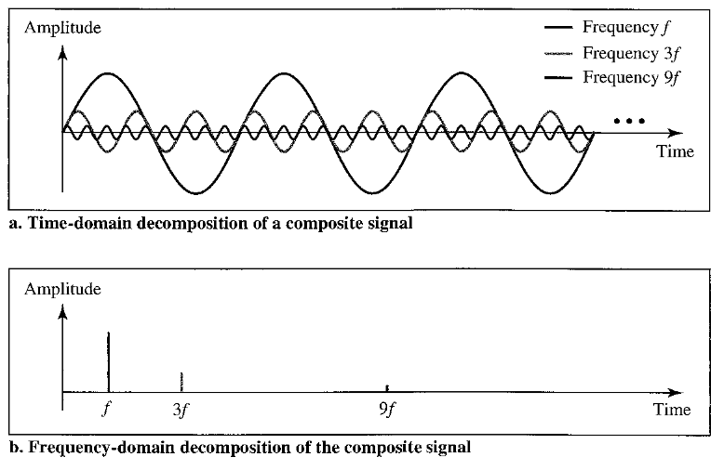
DECOMPOSITION OF COMPOSITE SIGNALS (PERIODIC)

Slide 22
DECOMPOSITION OF COMPOSITE SIGNALS (PERIODIC) (2)
It is very difficult to manually decompose this signal into a series of simple sine waves.
However, there are tools, both hardware and software, that can help us do the job. We are not concerned about how it is done; we are only interested in the result.
The frequency of the sine wave with frequency f is the same as the frequency of the composite signal; it is called the fundamental frequency, or first harmonic.
The sine wave with frequency 3f has a frequency of 3 times the fundamental frequency; it is called the third harmonic. The third sine wave with frequency 9f has a frequency of 9 times the fundamental frequency; it is called the ninth.

Slide 23
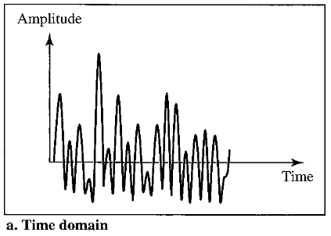
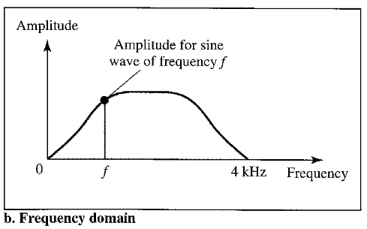
DECOMPOSITION OF COMPOSITE SIGNALS (NONPERIODIC)

Slide 24
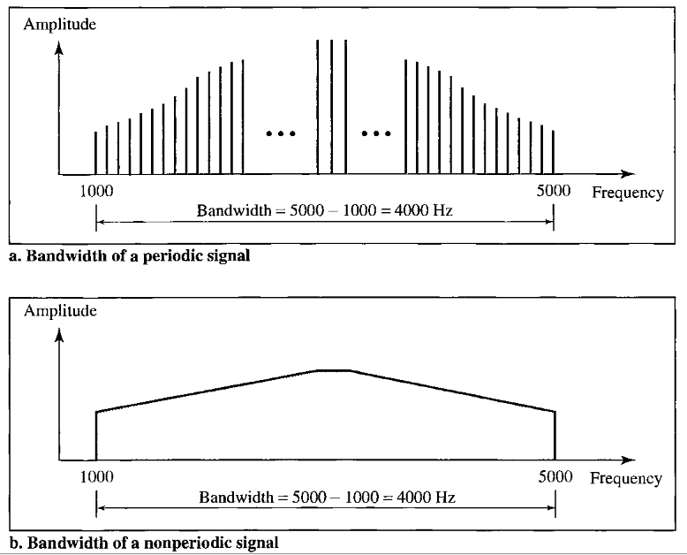
BANDWIDTH
The bandwidth of a composite signal is the difference between the highest and the lowest frequencies contained in that signal.

Slide 25
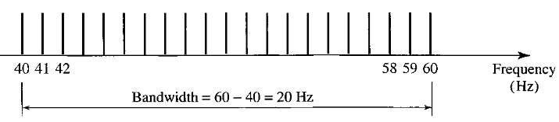
BANDWIDTH (2)
A periodic signal has a bandwidth of 20 Hz. The highest frequency is 60 Hz. What is the lowest frequency? Draw the spectrum if the signal contains all frequencies of the same amplitude.
Let f_{h} be the highest frequency, f_{l} the lowest frequency, and B the bandwidth. Then
B = f_{h} - f_{l} => 20 = 60 – f₁ => f_{l}= 60 - 20 = 40 Hz
The spectrum contains all integer frequencies. We show this by a series of spikes

Slide 26
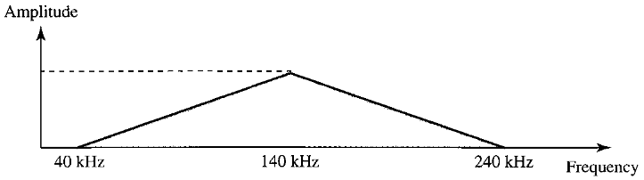
BANDWIDTH (3)
A nonperiodic composite signal has a bandwidth of 200 kHz, with a middle frequency of 140 kHz and peak amplitude of 20 V. The two extreme frequencies have an amplitude of 0. Draw the frequency domain of the signal.
The lowest frequency must be at 40 kHz and the highest at 240 kHz. Figure below shows the frequency domain and the bandwidth.

Slide 27
DIGITAL SIGNALS
Information can also be represented by a digital signal.
For example, a 1 can be encoded as a positive voltage and a 0 as zero voltage.
A digital signal can have more than two levels.
In this case, we can send more than 1 bit for each level. Figure below shows two signals, one with two levels and the other with four.

Slide 28
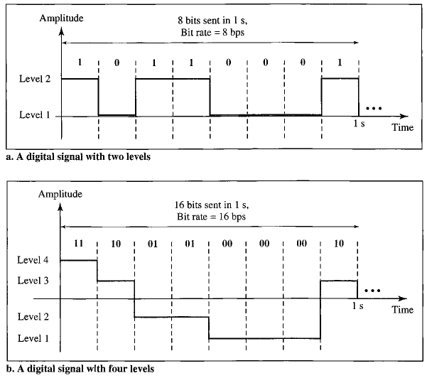
DIGITAL SIGNALS (2)

Slide 29
DIGITAL SIGNALS
If a signal has L levels, each level needs log₂L bits.
A digital signal has eight levels. How many bits are needed per level?
Number of bits per level = log₂8 = 3.
Each signal level is represented by 3 bits.
A digital signal has nine levels. How many bits are needed per level?
Each signal level is represented by 3.17 bits. However, this answer is not realistic. The number of bits sent per level needs to be an integer as well as a power of 2. For this example, 4 bits can represent one level.

Slide 30
BIT RATE
Bit rate is the number of bits sent in 1s, expressed in bits per seconds (bps)
A digitized voice channel is made by digitizing a 4-kHz bandwidth analog voice signal. We need to sample the signal at twice the highest frequency (two samples per hertz). We assume that each sample requires 8 bits. What is the required bit rate?
The bit rate can be calculated as
2 x 4000 x 8 = 64,000 bps = 64 kbps

Slide 31
BIT LENGTH
Bit length is the distance one bit occupies on the transmission medium
Bit length = propagation speed x Bit duration

Slide 32
DIGITAL SIGNAL AS A COMPOSITE ANALOG SIGNAL
A digital signal, in the time domain, comprises connected vertical and horizontal line segments.
A vertical line in the time domain means a frequency of infinity (sudden change in time); a horizontal line in the time domain means a frequency of zero (no change in time).
Going from a frequency of zero to a frequency of infinity (and vice versa) implies all frequencies in between are part of the domain.

Slide 33
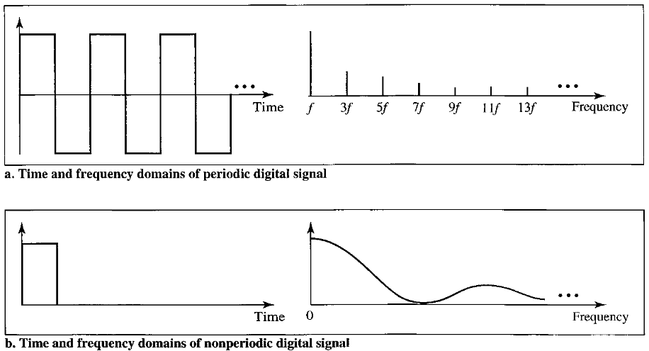
DIGITAL SIGNAL AS A COMPOSITE ANALOG SIGNAL
A digital signal is a composite analog signal with an infinite bandwidth.

Slide 34
DIGITAL SIGNAL AS A COMPOSITE ANALOG SIGNAL
Fourier analysis can be used to decompose a digital signal.
If the digital signal is periodic, which is rare in data communications, the decomposed signal has a frequency-domain representation with an infinite bandwidth and discrete frequencies.
If the digital signal is nonperiodic, the decomposed signal still has an infinite bandwidth, but the frequencies are continuous.

Slide 35
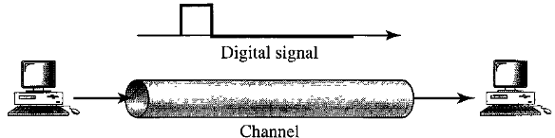
TRANSMISSION OF A DIGITAL SIGNAL
Two approaches
  Baseband transmission
  Broadband transmission
Baseband transmission means sending a digital signal over a channel without changing the digital signal to an analog signal.

Slide 36
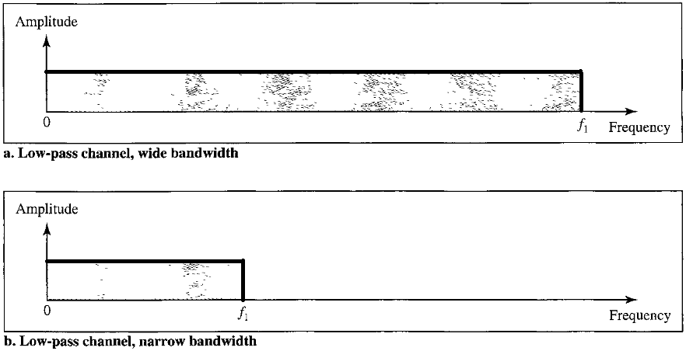
BASEBAND TRANSMISSION
Baseband transmission requires that we have a low-pass channel, a channel with a bandwidth that starts from zero.

Slide 37
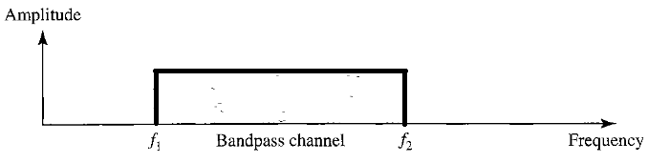
BROADBAND TRANSMISSION
Broadband transmission means changing the digital signal to an analog signal for transmission.
Modulation allows us to use a bandpass channel--a channel with a bandwidth that does not start from zero. This type of channel is more available than a low-pass channel.

Slide 38
BROADBAND TRANSMISSION (2)
If the available channel is a bandpass channel, we cannot send the digital signal directly to the channel; we need to convert the digital signal to an analog signal before transmission.
Note that a low-pass channel can be considered a bandpass channel with the lower frequency starting at zero.

Slide 39
BROADBAND TRANSMISSION - MODULATION
In modulation, a digital signal is converted to a composite analog signal.
We have used a single-frequency analog signal (called a carder); the amplitude of the carrier has been changed to look like the digital signal.
The result, however, is not a single-frequency signal; it is a composite signal.
At the receiver, the received analog signal is converted to digital, and the result is a replica of what has been sent.

Slide 40
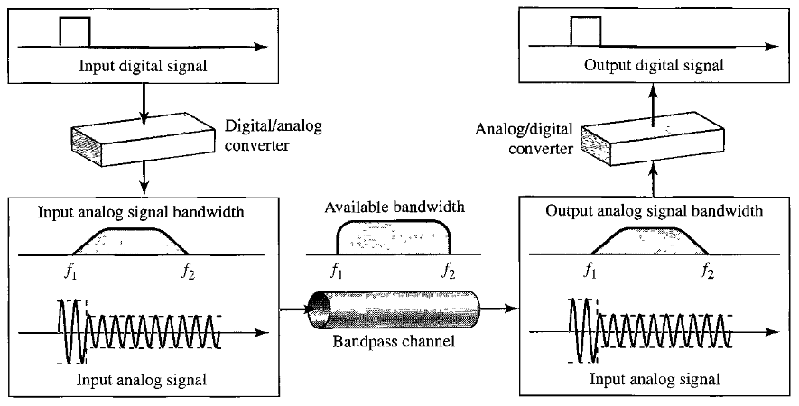
BROADBAND TRANSMISSION - MODULATION

Slide 41
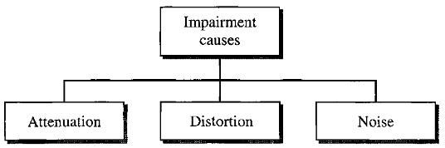
TRANSMISSION IMPAIRMENT
Signals travel through transmission media, which are not perfect.
The imperfection causes signal impairment. This means that the signal at the beginning of the medium is not the same as the signal at the end of the medium. What is sent is not what is received.
Three causes of impairment are attenuation, distortion, and noise

Slide 42
ATTENUATION
Attenuation means loss of energy.
When a signal travels through a medium, it loses some of its energy in overcoming the resistance of the medium.
That is why a wire carrying electric signals gets warm after a while.
Some of the electrical energy in the signal is converted to heat.
To compensate for this loss, amplifiers are used to amplify the signal.

Slide 43
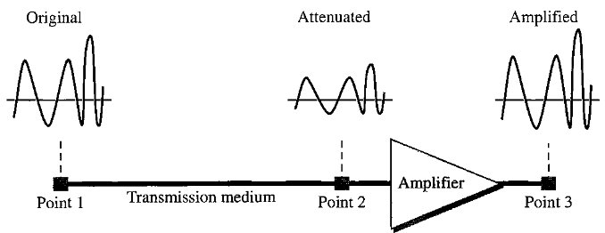
ATTENUATION

Slide 44
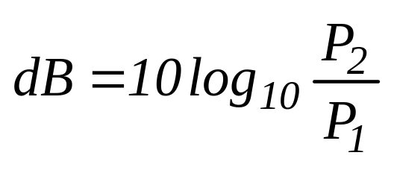
DECIBELS
To show that a signal has lost or gained strength, engineers use the unit of the decibel.
The decibel (dB) measures the relative strengths of two signals or one signal at two different points.
Note that the decibel is negative if a signal is attenuated and positive if a signal is amplified.

Slide 45
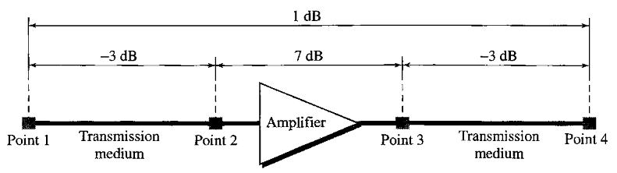
DECIBELS (2)
One reason that engineers use the decibel to measure the changes in the strength of a signal is that decibel numbers can be added (or subtracted) when we are measuring several points (cascading) instead of just two.
The resultant decibel value for the signal below is 1 dB

Slide 46

DECIBELS (3): EXAMPLE
Suppose a signal travels through a transmission medium and its power is reduced to one-half.
This means that P₂ = 0.5 P₁.
In this case, the attenuation (loss of power) is
A loss of 3 dB (-3 dB) is equivalent to losing one-half the power.

Slide 47

DECIBELS (4): EXAMPLE
A signal travels through an amplifier, and its power is increased 10 times.
This means that P₂ = 10P₁.
In this case, the amplification (gain of power) can be calculated as

Slide 48

DECIBELS (5): EXAMPLE
Sometimes the decibel is used to measure signal power in milliwatts !
In this case, it is referred to as dB_{m} and is calculated as dB_{m} = 10 log₁₀ P_{m}, where P_{m} is the power in milliwatts.
Calculate the power of a signal if its dB_{m} = -30.

Slide 49
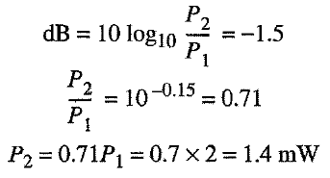
DECIBELS (6): EXAMPLE
The loss in a cable is usually defined in decibels per kilometer (dB/km). If the signal at the beginning of a cable with -0.3 dB/km has a power of 2 mW, what is the power of the signal at 5 km?
The loss in the cable in decibels is 5 x (-0.3) = -1.5 dB. We can calculate the power as

Slide 50
DISTORTION
Distortion means that the signal changes its form or shape.
Distortion can occur in a composite signal made of different frequencies. Each signal component has its own propagation speed through a medium and, therefore, its own delay in arriving at the final destination.
Signal components at the receiver have phases different from what they had at the sender. The shape of the composite signal is therefore not the same.

Slide 51
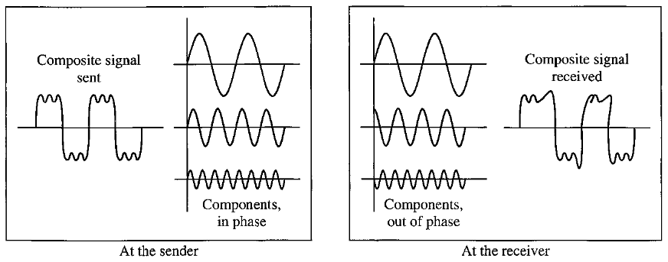
DISTORTION (2)

Slide 52
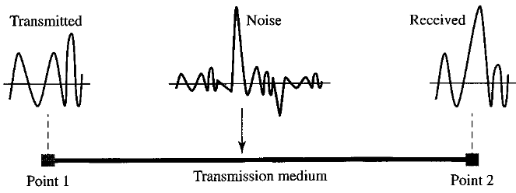
NOISE
Noise is another cause of impairment. Several types of noise, such as thermal noise, induced noise, crosstalk, and impulse noise, may corrupt the signal.
Thermal noise is the random motion of electrons in a wire which creates an extra signal not originally sent by the transmitter.

Slide 53
NOISE (2)
Induced noise comes from sources such as motors and appliances. These devices act as a sending antenna, and the transmission medium acts as the receiving antenna.
Crosstalk is the effect of one wire on the other. One wire acts as a sending antenna and the other as the receiving antenna.
Impulse noise is a spike (a signal with high energy in a very short time) that comes from power lines, lightning, and so on.

Slide 54

SIGNAL-TO-NOISE RATIO (SNR)
SNR is actually the ratio of what is wanted (signal) to what is not wanted (noise).
A high SNR means the signal is less corrupted by noise; a low SNR means the signal is more corrupted by noise.
We need to consider the average signal power and the average noise power because these may change with time.

Slide 55

SNR (2)
Because SNR is the ratio of two powers, it is often described in decibel units, SNR_{dB}, defined as
Why do we need SNR?
To find the theoretical bit rate limit of the communication medium, we need to know the ratio of the signal power to the noise power.

Slide 56
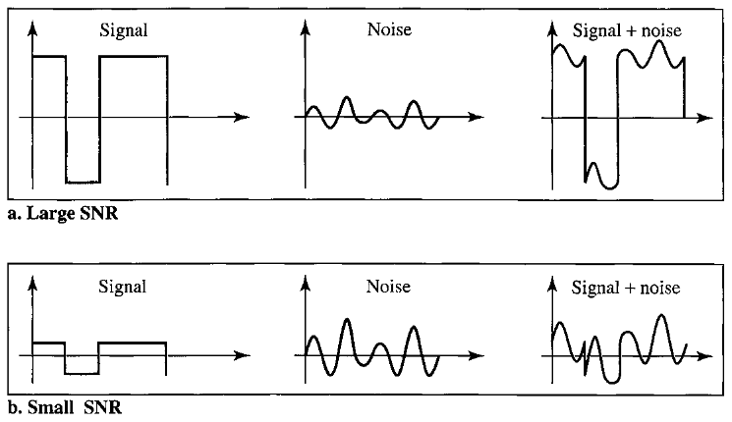
SNR (3)

Slide 57
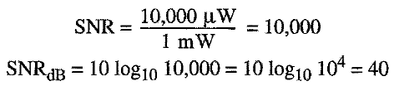
SNR (4)
The power of a signal is 10mW and the power of noise is 1 µW; what are the values of SNR and SNR_{dB} ?
The values of SNR and SNR_{dB} can be calculated as follows:

Slide 58

SNR (5)
The values of SNR and SNR_{dB} for a noiseless channel are
We can never achieve this ratio in real life; it is an ideal.

Slide 59
DATA RATE LIMITS
A very important consideration in data communications is how fast we can send data, in bits per second, over a channel.
Data rate depends on three factors:
  The bandwidth available
  The level of the signals we use
  The quality of the channel (the level of noise)
Two theoretical formulas were developed to calculate the data rate:
  Nyquist for a noiseless channel,
  Shannon for a noisy channel.

Slide 60
NOISELESS CHANNEL: NYQUIST BIT RATE
For a noiseless channel, the Nyquist bit rate formula defines the theoretical maximum bit rate
BitRate = 2 x bandwidth x log₂L
In this formula,
  BitRate is the bit rate in bits per second.
  bandwidth is the bandwidth of the channel,
  L is the number of signal levels used to represent data
According to the formula, we might think that, given a specific bandwidth, we can have any bit rate we want by increasing the number of signal levels.

Slide 61
NOISELESS CHANNEL: NYQUIST BIT RATE
Although the idea of increasing levels is theoretically correct, practically there is a limit. When we increase the number of signal levels, we impose a burden on the receiver.
If the number of levels in a signal is just 2, the receiver can easily distinguish between a 0 and a 1. If the level of a signal is 64, the receiver must be very sophisticated to distinguish between 64 different levels.
Therefore, increasing the levels of a signal reduces the reliability of the system !

Slide 62
NOISY CHANNEL: SHANNON CAPACITY
In reality, we cannot have a noiseless channel; the channel is always noisy.
In 1944, Claude Shannon introduced a formula, called the Shannon capacity, to determine the theoretical highest data rate for a noisy channel:
In this formula,
  Capacity is the capacity of the channel in bits per second.
  bandwidth is the bandwidth of the channel,
  SNR is the signal-to-noise ratio

Slide 63
NOISY CHANNEL: SHANNON CAPACITY
Note that in the Shannon formula there is no indication of the signal level.
It means that no matter how many levels we have, we cannot achieve a data rate higher than the capacity of the channel.
In other words, the formula defines a characteristic of the channel, not the method of transmission.
The Shannon capacity gives us the upper limit; the Nyquist formula tells us how many signal levels we need.

Slide 64
BITRATE EXAMPLE (1)
Consider a noiseless channel of 3 KHz transmitting a signal with four signal levels. What is the maximum bit rate
If we have four levels, then for each level, we send 2 bits.
Therefore, the maximum bit rate can be calculated as
BitRate = 2 x 3000 x log₂4 = 12,000 bps

Slide 65
BITRATE EXAMPLE (2)
We need to send 265 kbps over a noiseless channel with a bandwidth of 20 kHz. How many signal levels do we need?
We can use the Nyquist formula as shown:
265000 = 2 x 20000 x log₂L
=> log₂L = 6.625 L = 26625 = 98.7 levels
Since this result is not a power of 2, we need to either increase the number of levels or reduce the bit rate.
If we have 128 levels, the bit rate is 280 kbps. If we have 64 levels, the bit rate is 240 kbps.

Slide 66
BITRATE EXAMPLE (3)
Consider an extremely noisy channel in which the value of the signal-to-noise ratio is almost zero. Find out the capacity of the channel.
For this channel the capacity C is calculated as
C = B log₂(1 + SNR)
= B log₂(1 + 0)
= B log₂ 1
= B x 0
= 0

Slide 67
BITRATE EXAMPLE (4)
A telephone with bandwidth of 3000 Hz is assigned for data communications. The signal-to-noise ratio is 3162. What is the capacity of this channel?
For this channel the capacity is calculated as
C = B log₂(1 + SNR)
= 3000 log₂(1 + 3162)
= 3000 log₂ 3163
= 3000 x 11.62
= 34,860 bps

Slide 68
BITRATE EXAMPLE (5)
The signal-to-noise ratio is often given in decibels. Assume that SNR_{dB} = 36 and the channel bandwidth is 2 MHz. Find out the capacity?
The theoretical channel capacity can be calculated as
SNR_{dB} = 101og₁₀ SNR 
=> log₁₀ SNR = SNR_{dB} / 10
=> SNR = 10 ^{SNRdB/10} 
= 10^{3.6}
= 3981
C = B log₂ (1+ SNR) = 2 x 106 x log₂3982 = 24 Mbps

Slide 69
BITRATE EXAMPLE (6)
A channel of bandwidth 1 MHz with SNR 63 is given. What are the appropriate bit rate and signal level?
First, we use the Shannon formula to find upper limit.
C = B log₂ (1+SNR) = 10⁶ log₂(1+63) = 10⁶log₂64 = 6 Mbps
The Shannon formula gives us 6 Mbps, the upper limit. For better performance we choose something lower, 4 Mbps, for example.
Then we use Nyquist formula to find number of levels
4 Mbps=2 x l MHz x log₂L 
=> L=4

Slide 70
PERFORMANCE
Bandwidth
Throughput
Delay / Latency
Propagation time
Transmission time
Queuing time

Slide 71
BANDWIDTH
One characteristic that measures network performance is bandwidth.
However, bandwidth can be used in two different contexts with two different measuring values:
  Bandwidth in hertz and
  Bandwidth in bits per second.

Slide 72
BANDWIDTH IN HERTZ
Bandwidth in hertz is the range of frequencies contained in a composite signal or the range of frequencies a channel can pass.
For example, we can say the bandwidth of a subscriber telephone line is 4 kHz.

Slide 73
BANDWIDTH IN BITS PER SECONDS
The term bandwidth can also refer to the number of bits per second that a channel, a link, or even a network can transmit.
For example, one can say the bandwidth of a Fast Ethernet network (or the links in this network) is a maximum of 100 Mbps. This means that this network can send 100 Mbps.

Slide 74
THROUGHPUT
The throughput is a measure of how fast we can actually send data through a network.
Although, at first glance, bandwidth in bits per second and throughput seem the same, they are different.
Bandwidth is a potential measurement of a link; the throughput is an actual measurement of how fast we can send data.
For example, we may have a link with a bandwidth of 1 Mbps, but the devices connected to the end of the link may handle only 200 kbps. This means that we cannot send more than 200 kbps through this link.

Slide 75

THROUGHPUT EXAMPLE
A network with bandwidth of 10 Mbps can pass only an average of 12,000 frames per minute with each frame carrying an average of 10,000 bits. What is the throughput of this network?
We can calculate the throughput as
The throughput is almost one-fifth of the bandwidth in this case.

Slide 76
LATENCY
The latency or delay defines how long it takes for an entire message to completely arrive at the destination from the time the first bit is sent out from the source.
Latency is made of four components
  Propagation Time
  Transmission Time
  Queuing Time
  Processing Time

Slide 77


PROPAGATION AND TRANSMISSION TIME
Propagation time
  Measures the time required for a bit to travel to the destination
Transmission time
  Considers the total message instead of considering a single bit

Slide 78

PROPAGATION TIME EXAMPLE
What is the propagation time if the distance between the two points is 12,000 km? Assume the propagation speed to be 2.4 x 108 m/s in cable.
We can calculate the propagation time as

Slide 79
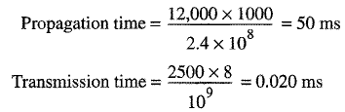
TRANSMISSION TIME EXAMPLE
What are the propagation time and the transmission time for a 2.5-kbyte message (an e-mail) if the bandwidth of the network is 1 Gbps? Assume that the distance between the sender and the receiver is 12,000 km and that light travels at 2.4 x 108 m/s.
We can calculate the propagation and transmission time as

Slide 80
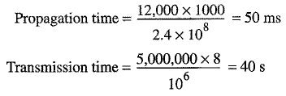
TRANSMISSION TIME EXAMPLE
What are the propagation time and the transmission time for a 5-Mbyte message (an image) if the bandwidth of the network is 1 Mbps? Assume that the distance between the sender and the receiver is 12,000 km and that light travels at 2.4 x 108 m/s.
We can calculate the propagation and transmission times as

Slide 81
LATENCY (2)
Queuing time
  The third component in latency is the queuing time, the time needed for each intermediate or end device to hold the message before it can be processed.
  The queuing time is not a fixed factor; it changes with the load imposed on the network.

Slide 82
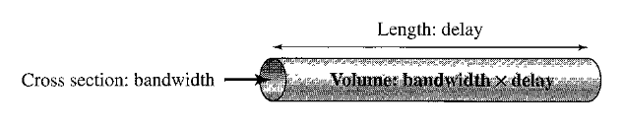
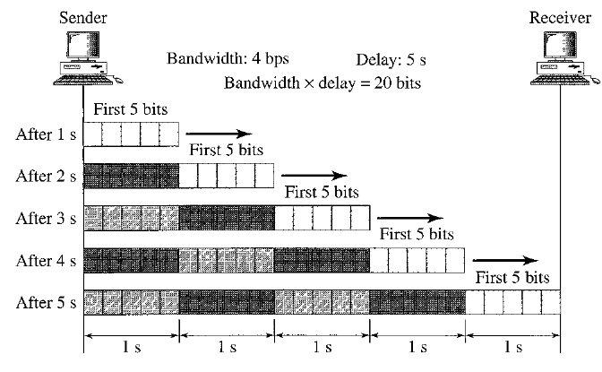
BANDWIDTH-DELAY PRODUCT
The bandwidth-delay product defines the number of bits that can fill the link.

